Slide 1
Hello, ML Alchemist
Jiaxun Yang

Slide 2
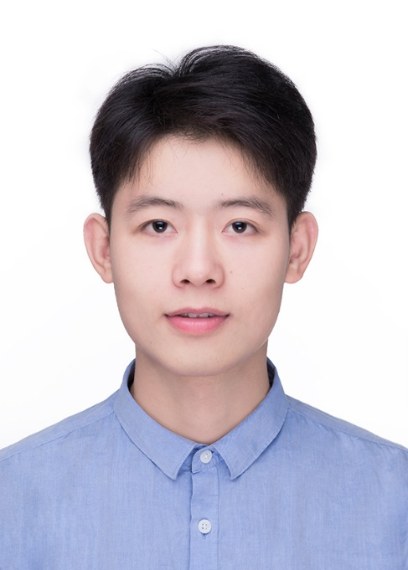
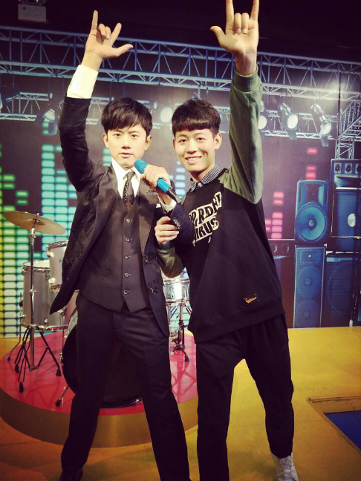
introduce oneself to
My name is Yang Jiaxun, ranking 1 / 404 (top 0.2%) in the comprehensive grade of Software Engineering Department of Nanchang University in 2017
GPA: 3.67 / 4.0, with a total of more than 90 points in 26 courses, including 96 points for advanced mathematics, 93 points for academic English, and 97 points for C language programming.
Cet-6:481.
Jiangxi smart city key laboratory.
My undergraduate research experience is the direction of small target detection;
I have had a deep research in this field.
We have used mmdetection toolbox, followed some one-stage, two stage; anchor based, anchor free models.
Notes:
夸一句，谢一句，讲自己，祝未来，这样的自我介绍，比较适用于人多时候的演讲，可长可短，可以调整顺序。举个例子：
夸一句：积极阳光爱学习的朋友们，大家好！
谢一句：感谢大家来参加口才陪伴营的课程
讲自己：我叫晨子，是一名沟通教练，很高兴认识大家
祝未来：祝我们通过21天的学习，每个人都可以拥有好口才，遇见更好的自己！
感谢大家来听我的自我介绍。

Slide 5
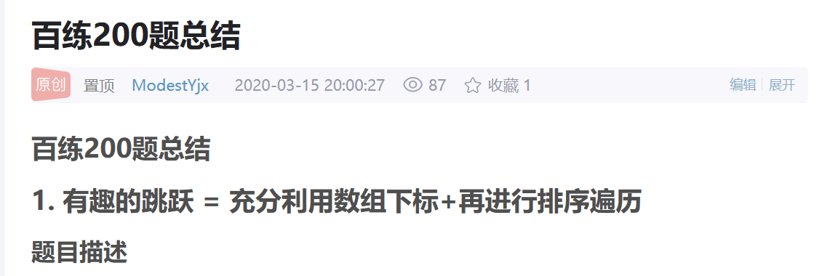
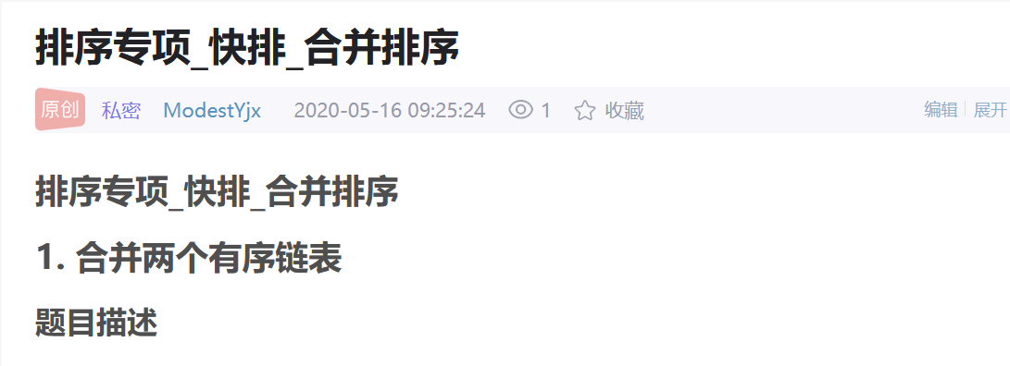
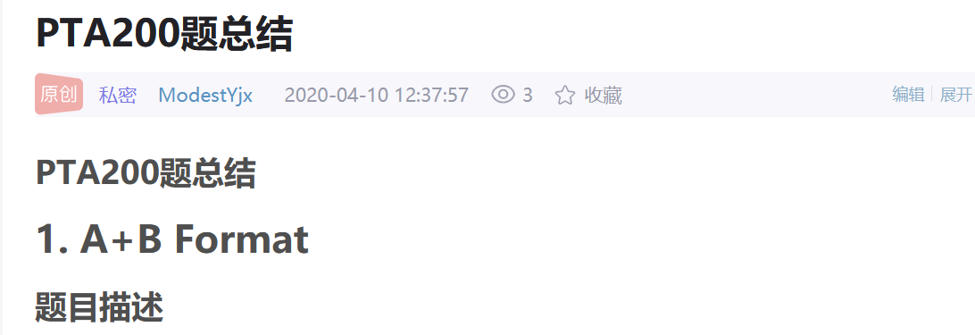
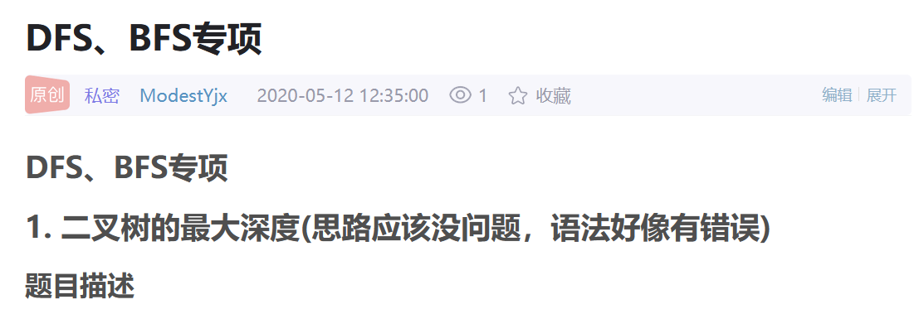
academic record
1. The programming courses are 92 points, familiar with Python and C + +.
2. Good basic mathematics skills, 96 points for advanced mathematics; 91 points for English courses.
3. In leetcode and POJ, more than 500 questions are written, and blogs are often written; programming and ability are better.

Slide 7


Progress
Two stage：
SNIP
SNIPER
TridentNet
ATSS
FSAF
R-CNN
Faster R-CNN
FPN
Stitcher
RepPoints
Fast R-CNN
YOLO
RetinaNet
CornerNet
YOLO4
One stage：
2014
2015
2016
2017
2018
2019
2020
recent
The process becomes more and more simplified, the accuracy is higher and higher, and the speed is faster and faster.
At present, generally speaking, the accuracy of anchor based is higher, and anchor free may be the future trend.
It is necessary to solve the problem of imbalance in target detection, such as imbalance of positive and negative samples, imbalance of IOU distribution, and imbalance of object scale.
Notes:
two stage算法需要先生成proposal，再进行分类和回归 直接在网络中提取特征来预测物体分类和位置。

Slide 8
Unbalanced summary of target detection
There are many kinds of imbalances in target detection, which will affect the final detection accuracy. The summary is as follows:
category | sketch
Imbalance of positive and negative samples | The foreground and background are unbalanced, and the number of different types of input bounding boxes in the foreground is unbalanced.
Scale imbalance | The scale of input image and bounding box is unbalanced, and the contribution of different feature layers to the final result is unbalanced.
Spatial imbalance | The distribution of IOU is unbalanced, and the contribution of different samples to regression loss is unbalanced.
Imbalance of objective function | The contribution of different tasks (such as regression and classification) to global loss is unbalanced.

Slide 9
Improvement based on Anchor Based
angle | paper | mAP | Job description
Data level | Stitcher | 41.3(Res-101-FPN) | Sticcher = use the threshold value of loss of small and medium-sized targets in a single picture to convert the large and medium-sized targets into small and medium-sized targets, and then re join the training.(equivalent to data expansion)
Network level | FPN | 36.2 | The multi-scale feature fusion (before convolution operation in the current layer, add the sampling on the feature map of the previous layer and the feature map of the current layer, that is, by fusing the sampling on the feature map of the previous layer and the features of the shallow layer to get the deep features) is adopted for prediction.
 | RetinaNet | 40.8(ResNeXt-101-FPN) | In order to solve the problem of class imbalance, the cross entropy loss criterion is reshaped. By reducing the weight of samples that are easy to classify, this function makes the model focus more on the samples that are difficult to classify during training, so as to improve the class imbalance of samples and the optimization direction of the model.
 | TridentNet | 48.4(ResNet-101-Deformable ) | For the same object, different sizes of receptive fields are used to achieve data augmentation + sharing of weight parameters to bring adaptability to various scales.
 | Adaptive Training Sample Selection | 50.7((Multi-scale testing) | ATSs = adaptive sample selection (adjust the IOU threshold dynamically according to the adaptive threshold TG = Mg + VG).

Slide 10
Improvement based on anchor free
angle | paper | mAP | Job description
Corner (false free) | Cornernet (ancestor) | 44.6 | Cornernet = replace the bounding box with a set of points in the upper left corner and the lower right corner + a new pooling method, cornernet pooling.
Center point (false free) | Centernet (cornernet improvement) | 47.0(Hourglass-104 ) | On the basis of cornernet, a center point prediction is added. The requirement to form an object is not only that two vertices can match, but also that the center of the frame defined by these two vertices should have corresponding center points.
Key points (true free) | Reppoints (propose using keys to represent objects) | 46.5 | Directly predict 9 representative points (these vertices have no clear semantics), and then find the tightest frame surrounding the 9 points and calculate the loss with GT.Then loss only returns the points that contribute to the generation of the box.
Feature layer selection (false free) | Adaptive Training Sample Selection | 42.1 | Retinanet + fsaf = online selection of feature graph based on loss calculation of anchor free branch + anchor based and anchor free joint training can significantly improve performance.

Slide 11
Anchorfitted: feedback driven target detection anchor arbiter

Slide 12
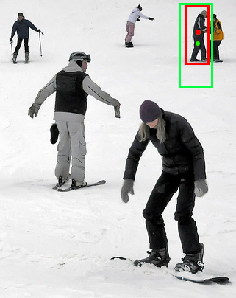
Conjecture experiment
 | min range | max range
Small | 0×0 | 32×32
Medium | 32×32 | 96×96
Large | 96×96 | ∞×∞
1. In the coco data set, we found that: there are many small targets (41.43%), but the distribution is very uneven, nearly 50% of the images have no small targets.
2. On average, small objects can only match one anchor, while large objects can match 2.54 anchors; the average IOU of small objects is only 0.29, and the average IOU of large objects is 0.66.
3. Even if the target is inside the anchor, because the IOU is too low, the anchor will still be misjudged as false positive, and it is not easy to get a better positive sample.
 | Object Count | Images | Average matching anchors | Average max loU
small | 41.43% | 51.82% | 1.00 | 0.29
medium | 34.32% | 70.07% | 1.03 | 0.57
large | 24.24% | 82.28% | 2.54 | 0.66
GT in red;
The green box is anchor;
Even if the GT is inside the anchor, because the IOU is too low,
This anchor will still be misjudged as false positive.

Slide 13
Apsmall is more than twice lower than aplarge - > small object learning is not enough - > it needs to strengthen the learning of small objects.
By introducing a feedback driven anchor arbiter, the recursive function can dynamically adjust the size of the anchor frame and close the gap between the anchor and the small target by gradually reducing the gap between the anchor and the small target, thus providing more excellent positive samples (to solve the problems 1 and 3 in the conjecture experiment).
Then, a groupiou balance sampling strategy is used to ensure sufficient number of positive and negative samples with balanced proportion to participate in model training at each scale, so as to avoid small gradients generated by simple samples being submerged by large gradients generated by difficult samples (to solve conjecture experiment problem 2).

Slide 14
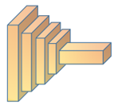
1. Through the anchored module (red box), the anchor without the assigned label is more suitable for the small target, so as to solve the problem that the IOU is too small and the proposal is lost due to the improper anchor.
2. Groupiou balance sampling (green box) can avoid small gradients generated by simple samples being submerged by large gradients generated by difficult samples, so that the classifier will obtain balanced training samples of different sizes.
Group IoU Balance sampling module
N
Group IoU Balance sampling
Gt in Anchor &
GT never assign label?
Anchorfitted module
Y
Y
Anchorfitted arbiter
N
Gt in Anchor?

Slide 15
Anchorfitted module
1. Introduce a consensus mechanism: if 1) GT is given a positive label for the first time; 2) GT is inside the anchor, the anchor uses the anchored module.
2. Recursively scale the length and width of the anchor to 4 / 5, until the anchor no longer contains GT, and get the final anchor.
N
Group IoU Balance sampling
Gt in Anchor &
GT never assign label?
Y
Anchorfitted module
Y
N
Anchorfitted arbiter
Gt in Anchor?

Slide 16
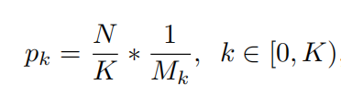
Group IoU Balance sampling
1. Divide all anchors into several groups according to their scales.
2. For each group, keep the proportion of positive and negative samples at 3:1, and then divide the value of IOU into k intervals.
3. N negative samples are sampled in each interval, and the number of candidate samples in each interval is Mk. The specific sampling formula is as follows:
For each scale, the larger the IOU value in the interval, the smaller the probability
4. Through the uniform sampling on the IOU, the hard negative is evenly distributed on the IOU.

Slide 17
1. Taking resnet-50 FPN faster r-cnn as the baseline, groupiou balance sampling improved by 0.9 AP points, proving the effectiveness of groupiou balance sampling.
Group loU-balanced Sampling | AP | AP_{S} | APm | APl
 | 35.9 | 21.2 | 39.5 | 46.4
A kind of | 36.8(+0.9) | 22.3(+1.1) | 40.3(+0.8) | 46.7(+0.3)

Slide 18
1. With res-50-fpn as the backbone, the lifting on small objects is larger, 1.5 AP higher than fast r-cnn, and 0.9 AP higher than fast r-cnn.
2. Taking res-101-fpn as the backbone, the APS on small objects is 1.7 higher than that on retinaet.
baseline | backbone | AP | APs | APm | APl
Faster R-CNN(baseline) | Res-50-FPN | 36.7 | 21.1 | 39.9 | 48.1
Anchorfitted |  | 37.5(+0.9) | 22.6(+1.5) | 40.2(+0.3) | 48.7(+0.6)
baseline | backbone | AP | APs | AP_{m} | APl
RetinaNet(baseline) | Res-101-FPN | 39.1 | 22.6 | 42.9 | 51.4
Anchorfitted |  | 40.2(+1.1) | 24.3(+1.7) | 43.2(+0.3) | 51.7(+0.3)

Slide 19
Based on energy welfare function
Energy saving routing algorithm based on WSN

Slide 20
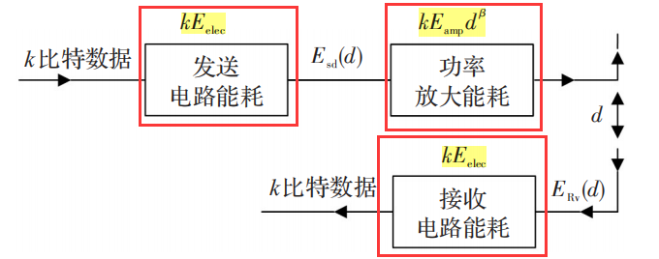
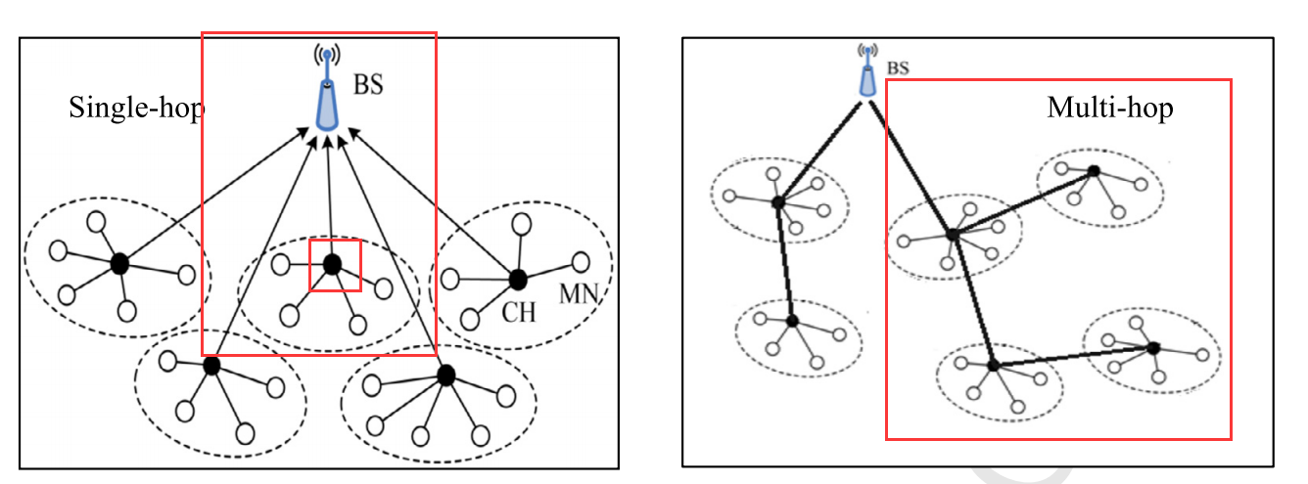
Energy saving routing algorithm of sensor network based on energy welfare function
An energy-saving routing algorithm based on energy welfare function is proposed.The threshold value is optimized when selecting the temporary cluster head, and the energy cost formula is used to determine the cluster members and the final cluster head.
In the stage of inter cluster routing, a combination of single hop and multi hop is used to select relay nodes.
Radio energy consumption model
Single hop
Multihop

Slide 22
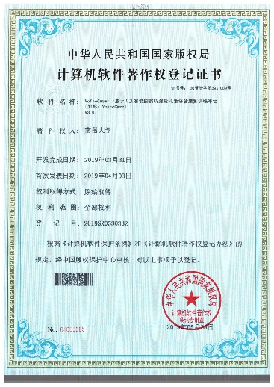
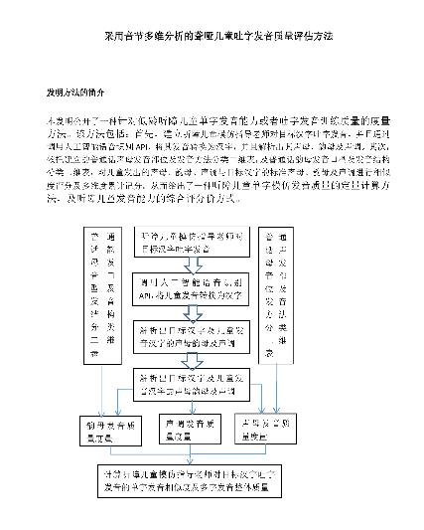
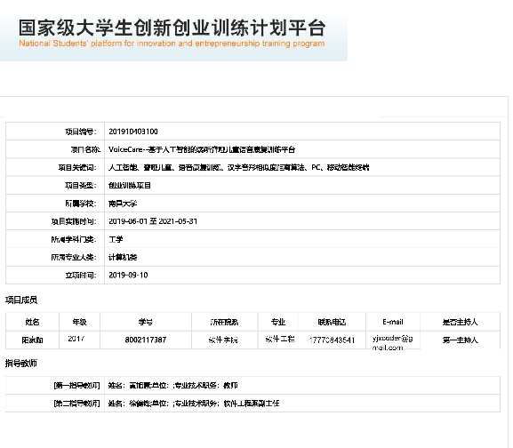
Scientific research achievements
IEEE Systems Journal: the second author of a novel WSNs based on energy well function (teacher first)
National innovation and entrepreneurship training program for college students: voicecare -- the first person in charge of speech rehabilitation training platform for deaf and mute children based on Artificial Intelligence
National patent: core member of speech quality assessment method for deaf mute children using syllable multidimensional analysis
Software copyright: the first person in charge of speech rehabilitation training system for deaf and mute children based on Artificial Intelligence

Slide 23


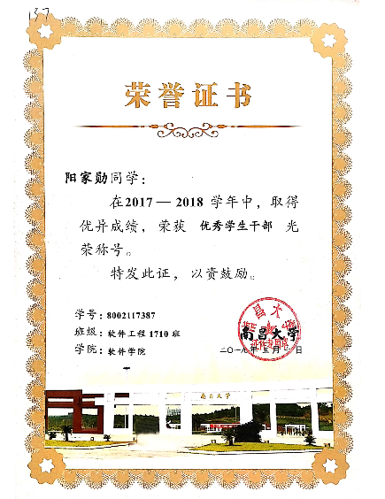
honor
2017-2018:
2018-2019:
National inspirational Scholarship (award rate: 2%)
National Endeavor Fellowship
Special scholarship of Nanchang University (award rate: 1.5%)
Special scholarship of Nanchang University
Three good student pacesetters of Nanchang University (award rate: 2%)
Student cadres of Nanchang University
Three good students of Nanchang University (award rate: 5%)

Slide 24

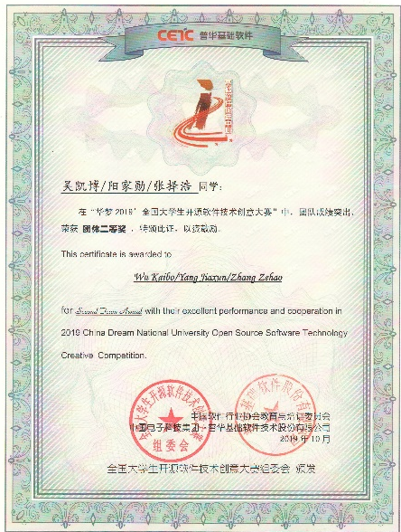

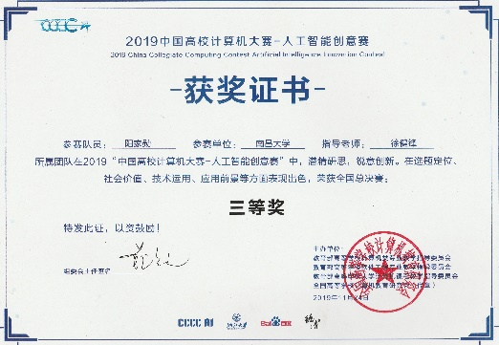


Competition Award
Second prize of China's "Ai +" innovation and Entrepreneurship Competition (ranking first, award rate: 1%)
National second prize of national open source software technology innovation competition for college students (ranking second, award rate: 2%)
Second prize of national software and information technology competition of Blue Bridge Cup (ranking first, award rate: 7%)
Third prize of China Computer Design Competition (ranking first, award rate: 7%)
National computer technology and software professional software designer
Apmcm Asia Pacific University Mathematical Modeling Competition international second prize (ranking first, award rate: 10%)

Slide 26
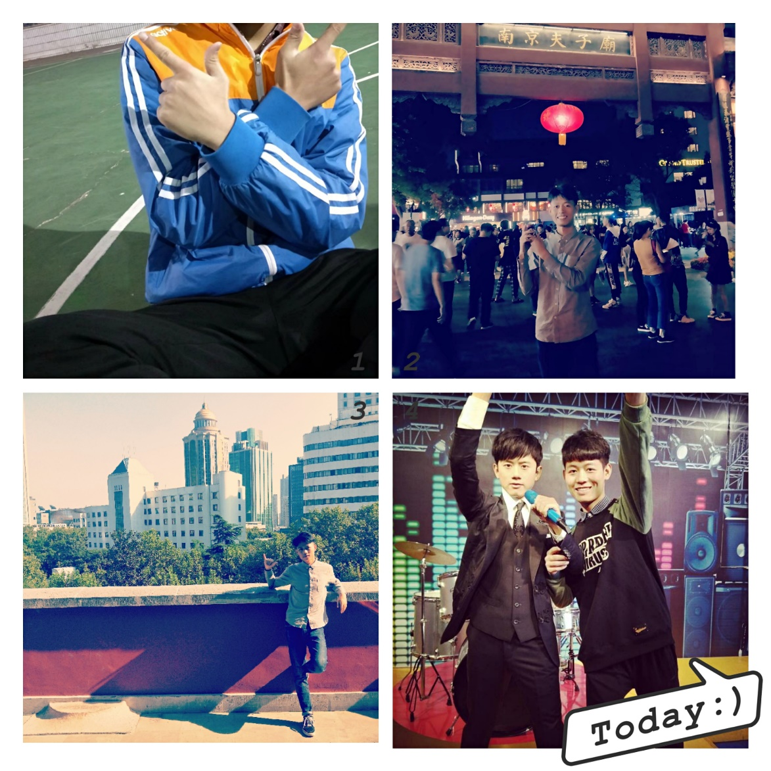
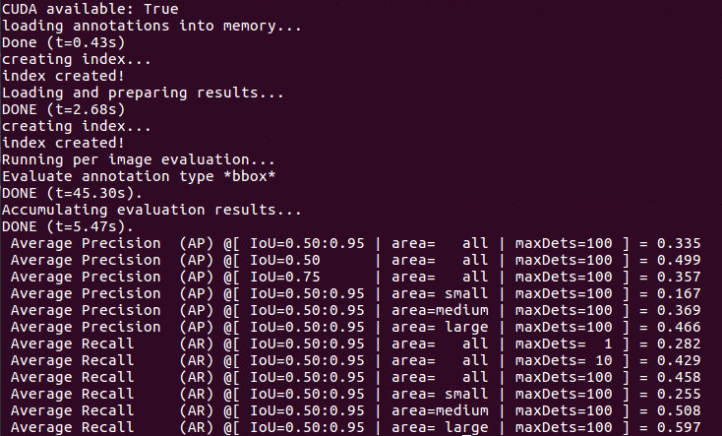
hobby
Play basketball and keep fit every week;
Set goals and make plans for yourself;
I was obsessed with reading literature and doing experiments; I had the experience of sudden imagination in the middle of the night, getting up and running the next morning.

Slide 28
Future work plan
1. Work in machine learning and data mining.
2. I know that my ability is still lacking, but my heart of learning is urgent and powerful!
3. NJU is my ideal place for further study!I hope I can get the teacher's guidance, learn more and publish a really valuable article during my graduate study!

Slide 29
Graduate stage arrangement
1. Learning: I will seriously study professional courses and improve my knowledge structure.
2. English: will not relax English learning, professional literature reading, foreign journal reading.
3. Scientific research: 1) first of all, we should learn to write standard papers, communicate with teachers and senior brothers and sisters, learn from them, and help teachers to complete scientific research tasks.2) Usually read more literature, work harder in the field of machine learning that you are interested in, actively participate in the research projects of the tutor, try to put forward measures, and strive to publish real valuable articles in top conferences or journals.

Slide 30
Thank you
q & a

